Slide 1
Probability Reasoning
Donghai Guan
NUAA

Slide 2
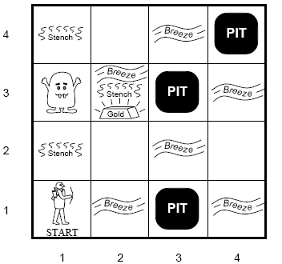
Wumpus World
Environment
  Cave of 4×4
  Agent enters in [1,1]
  16 rooms
    Wumpus: A deadly beast who kills anyone entering his room.
    Pits: Bottomless pits that will trap you forever.
    Gold

Slide 3
Wumpus World
Agents Sensors:
  Stench next to Wumpus
  Breeze next to pit
  Glitter in square with gold
  Bump when agent moves into a wall
  Scream from wumpus when killed
Agents actions
  Agent can move forward, turn left or turn right
  Shoot, one shot

Slide 4
Wumpus World
Performance measure
  +1000 for picking up gold
  -1000 got falling into pit
  -1 for each move
  -10 for using arrow

Slide 5
Reasoning in the Wumpus World
Agent has initial ignorance about the configuration
  Agent knows his/her initial location
  Agent knows the rules of the environment
Goal is to explore environment, make inferences (reasoning) to try to find the gold.
Random instantiations of this problem used to test agent reasoning and decision algorithms.

Slide 6
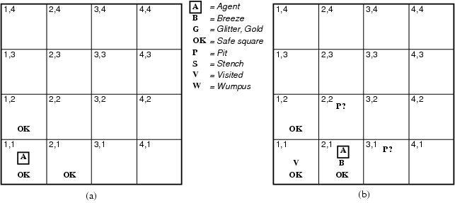
Exploring the Wumpus World
[1,1] The KB initially contains the rules of the environment.
The first percept is [none, none,none,none,none],
move to safe cell e.g. 2,1

Slide 7
Exploring the Wumpus World
[2,1] = breeze
indicates that there is a pit in [2,2] or [3,1],
return to [1,1] to try next safe cell

Slide 8
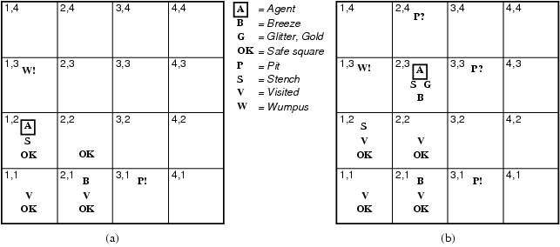
Exploring the Wumpus World
[1,2] Stench in cell which means that wumpus is in [1,3] or [2,2]
YET … not in [1,1]
YET … not in [2,2] or stench would have been detected in [2,1]
(this is relatively sophisticated reasoning!)

Slide 9
Exploring the Wumpus World
[1,2] Stench in cell which means that wumpus is in [1,3] or [2,2]
YET … not in [1,1]
YET … not in [2,2] or stench would have been detected in [2,1]
(this is relatively sophisticated reasoning!)
THUS … wumpus is in [1,3]
THUS [2,2] is safe because of lack of breeze in [1,2]
THUS pit in [1,3] (again a clever inference)
move to next safe cell [2,2]

Slide 10
Exploring the Wumpus World
[2,2] move to [2,3]
[2,3] detect glitter , smell, breeze
THUS pick up gold
THUS pit in [3,3] or [2,4]

Slide 11
Probability Overview
Events
  discrete random variables, continuous random variables, compound events
Axioms of probability
  What defines a reasonable theory of uncertainty
Independent events
Conditional probabilities
Bayes rule and beliefs
Joint probability distribution
Expectations
Independence, Conditional independence

Slide 12
Random Variables
Informally, A is a random variable if
  A denotes something about which we are uncertain
  perhaps the outcome of a randomized experiment
Examples
  A=True if a randomly drawn person from our class is female
  A=The hometown of a randomly drawn person from our class
  A=True if two randomly drawn persons from our class have same birthday
Define P(A) as “the fraction of possible worlds in which A is true” or “the fraction of times A holds, in repeated runs of the random experiment”
  The set of possible worlds is called the sample space, S
  A random variable A is a function defined over S
  A: S → {0,1}
Notes:
Tossing a coin: {Head, Tail}
Rolling a die: {1,2,3,4,5,6}

Slide 13
A little formalism
A sample space S (e.g., set of students in our class)
  aka the set of possible worlds
A random variable is a function defined over the sample space
  Gender: S→{m,f}, Height:S→Reals
An event is a subset of S
  e.g., the subset of S for which Gender=f
  e.g., the subset of S for which (Gender=m) and (eyecolor=blue)
We are often interested in probabilities of specific events
And of specific events conditioned on other specific events

Slide 14
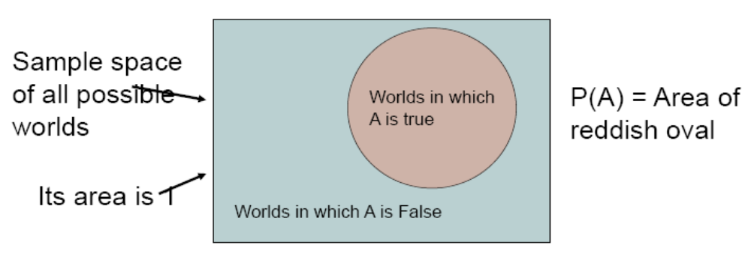
Visualizing A

Slide 15
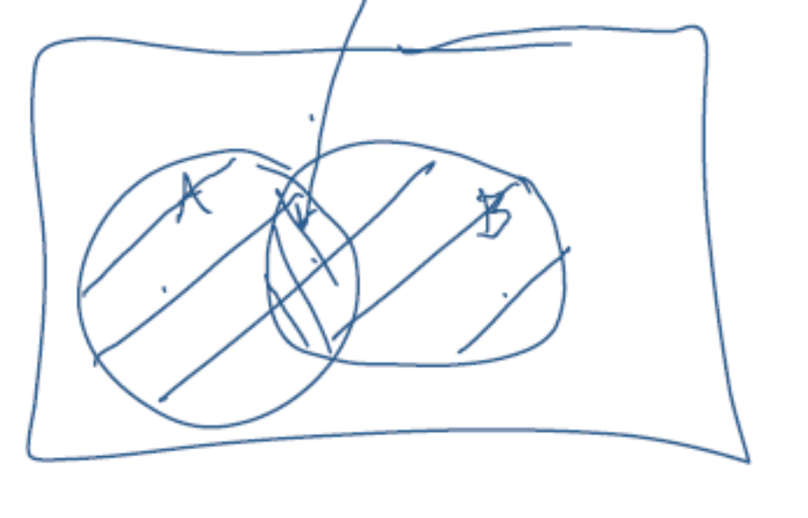
The Axioms of Probability
0 <= P(A) <=1
P(True)=1
P(False)=0
P(A or B)=P(A) + P(B) –P(A and B)

Slide 16
Interpreting the axioms
The area of A can’t get any smaller than 0
And a zero area would mean no world could ever have A true
The area of A can’t get any larger than 1
And an area of 1 would mean all worlds will have A true

Slide 17
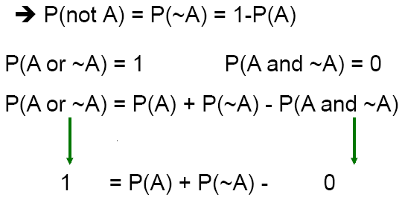
Theorems from the Axioms
0 <= P(A) <=1, P(True)=1, P(False)=0
P(A or B)=P(A) + P(B) –P(A and B)

Slide 18
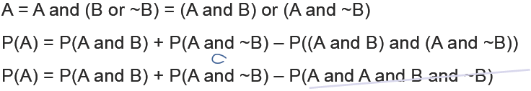
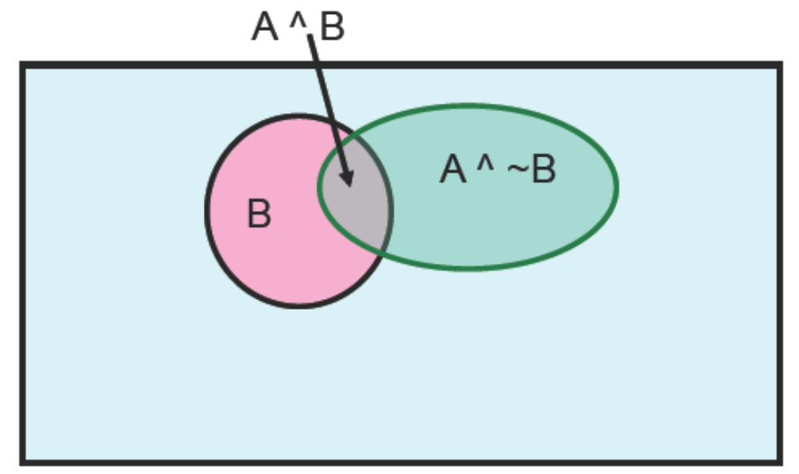
Elementary Probability in Pictures
P(~A) + P(A) =1
P(A)=P(A ^ B) + P(A ^ ~B)

Slide 19
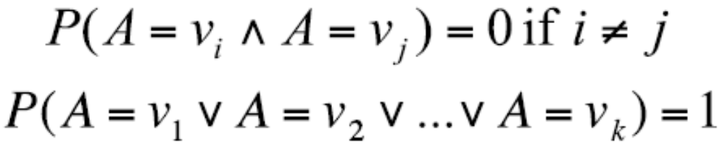
Multivalue Discrete Random Variables
Suppose A can take more than 2 values
A is a random variable with arity k if it can take on exactly one value out of {v₁,v₂,…,v_{k}}
Thus…

Slide 20
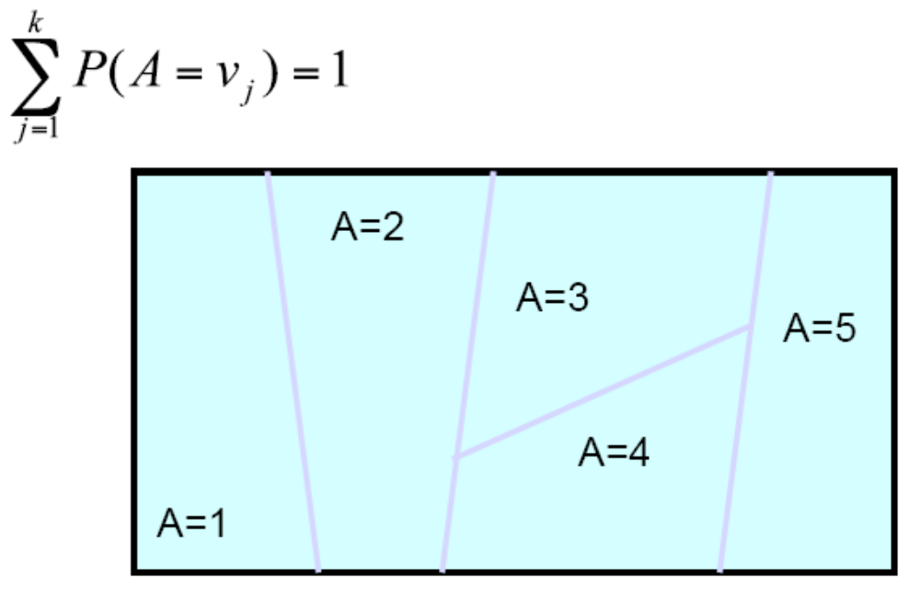
Elementary Probability in Pictures

Slide 21
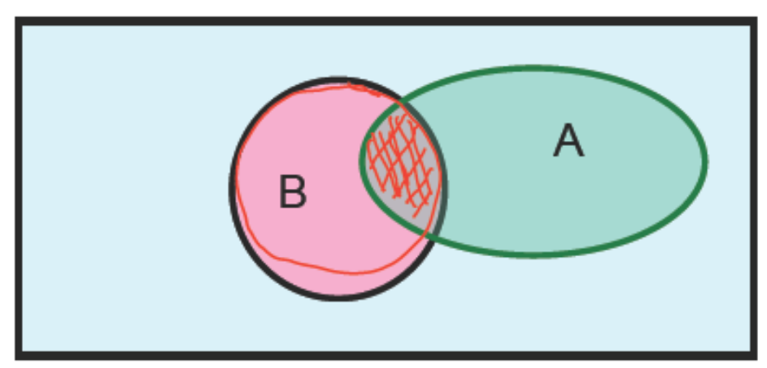
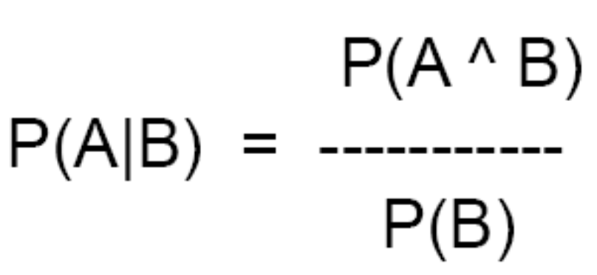
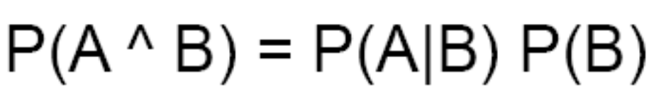
Definition of Conditional Probability
Corollary: The Chain Rule

Slide 22
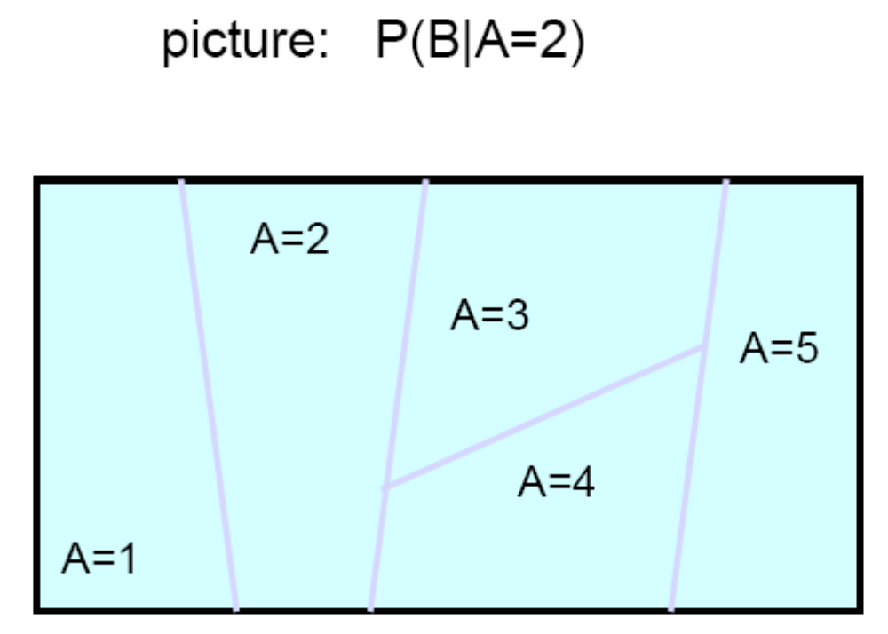
Conditional Probability in Pictures

Slide 23
Independent Events
Definition: two events A and B are independent if Pr(A and B)=Pr(A)*Pr(B)
Intuition: knowing A tells us nothing about the value of B (and vice versa)

Slide 24
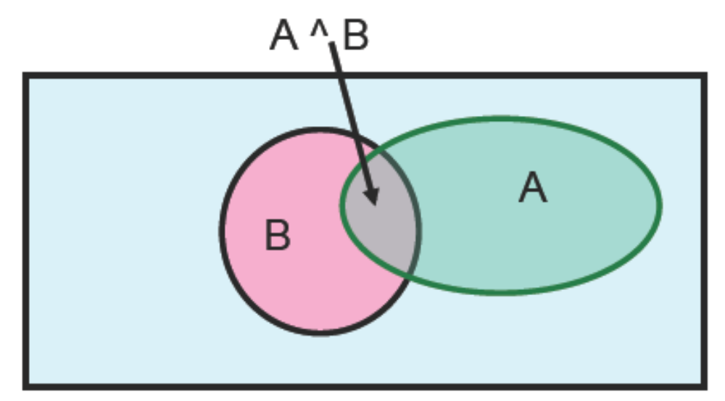
Elementary Probability in Pictures
Let’s write 2 expressions for P(A ^ B)

Slide 25
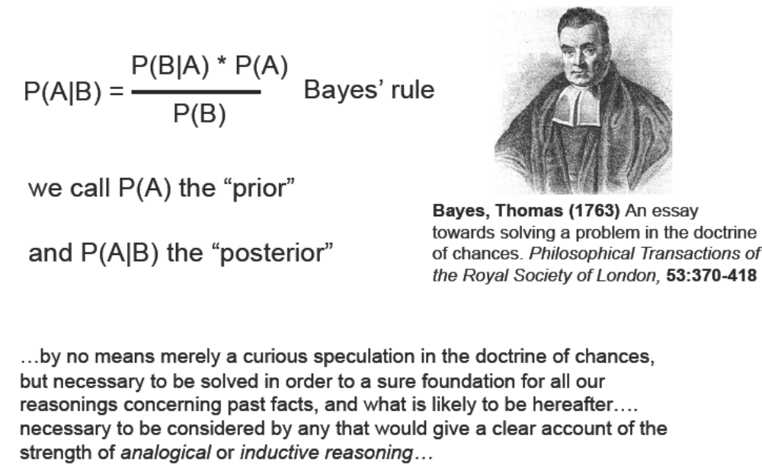
Bayes Rule

Slide 26
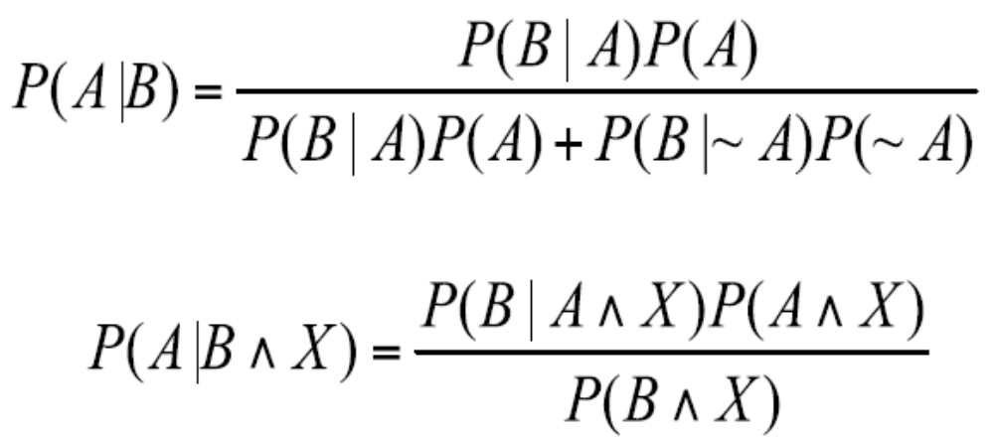
Other Forms of Bayes Rule

Slide 27
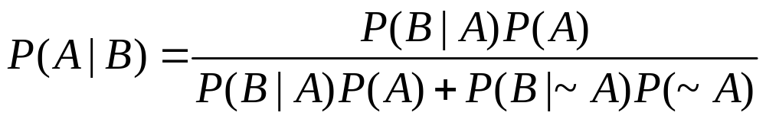
Applying Bayes Rule
A=you have the flu, B=you just coughed
Assume:
P(A)=0.05
P(B|A)=0.80
P(B|~A)=0.2
What is P(flu|cough)=P(A|B)?

Slide 28
What does all this have to do with
function Approximation??
f: X→Y
P(Y|X)

Slide 29
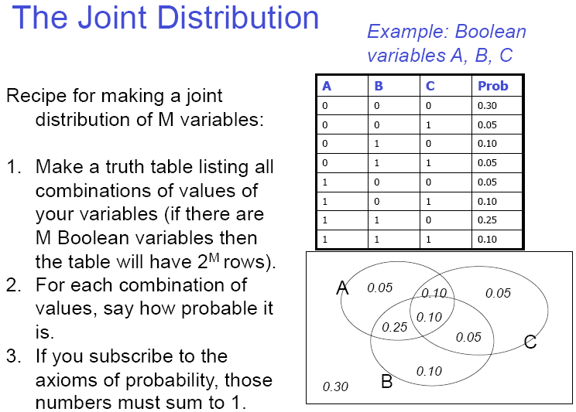
The Joint Distribution

Slide 30
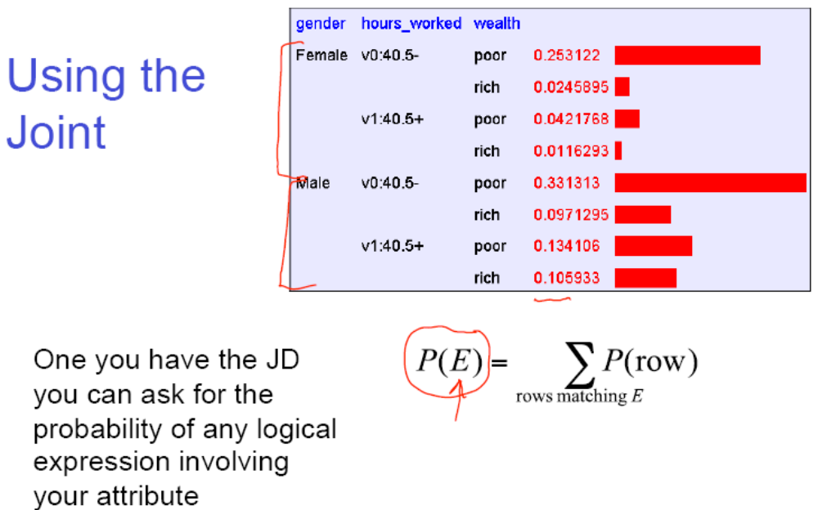
Using the Joint

Slide 31
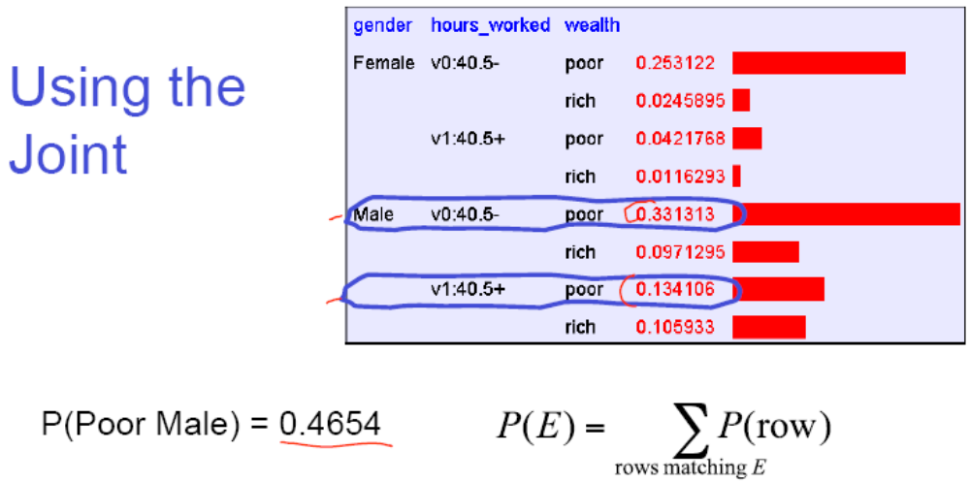

Slide 32
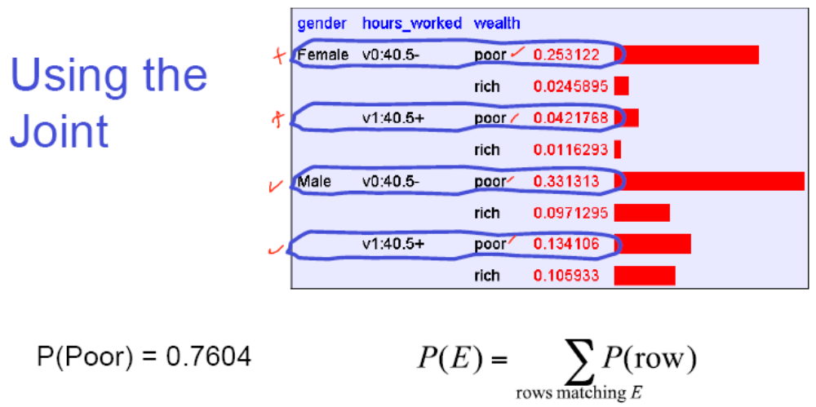

Slide 33
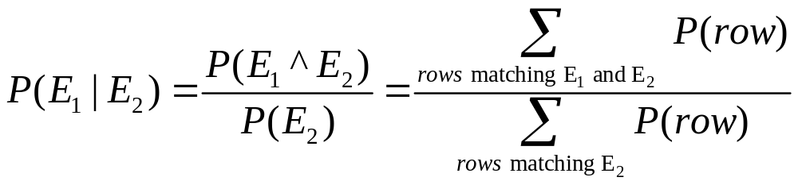
Inference with the Joint
P(Male | Poor)=??

Slide 34
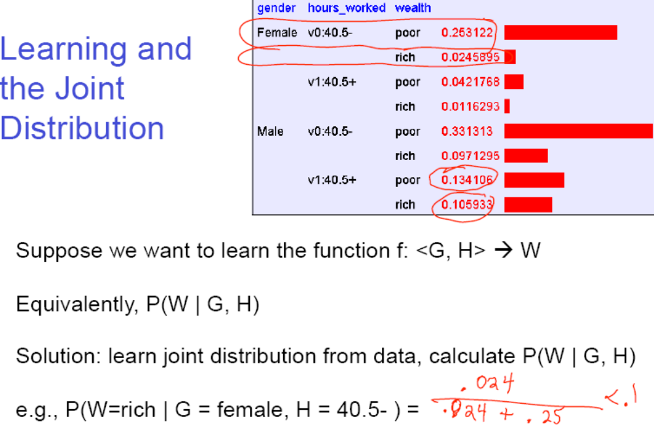
Notes:
Bayes rule example: http://www.montgomerycollege.edu/faculty/~jriseber/public_html/wquiz7-4b.htm

Slide 35
Summary
Questions?
Thank You!

